Slide 1
Offer Some Donuts

Slide 2
People are spiritually dead.

Slide 3
"As for you, you were dead in your transgressions and sins, in which you used to live when you followed the ways of this world..." Eph 2:1

Slide 4
"But because of his great love for us, God, who is rich in mercy, made us alive with Christ..." Eph 2:4

Slide 5
We are talking with people who are spiritually dead, and only God can make them come alive.

Slide 6
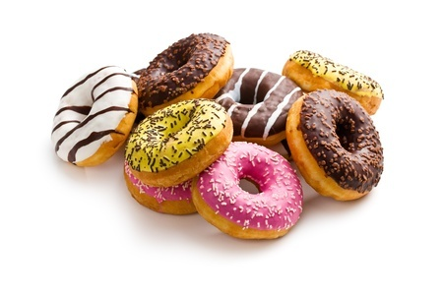

Slide 7
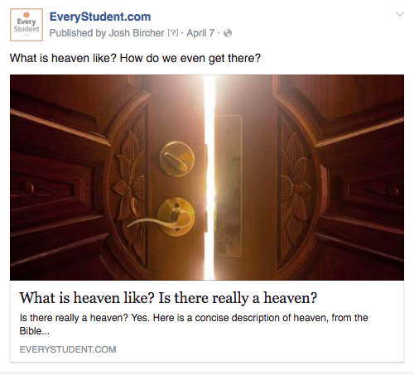

Slide 10
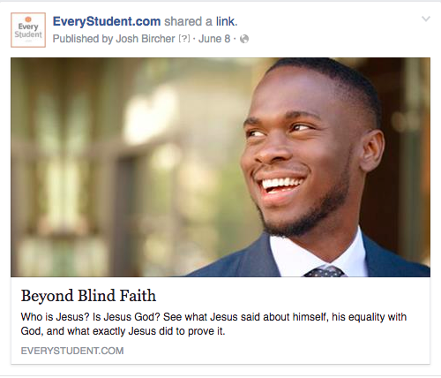

Slide 11
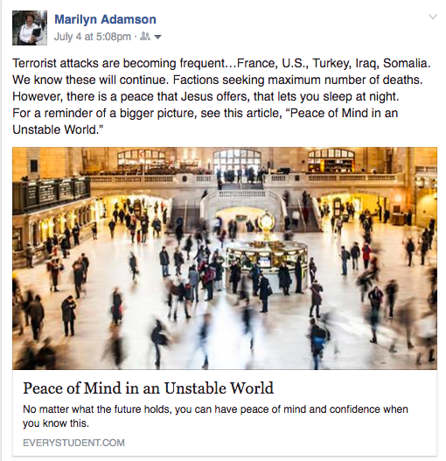

Slide 12
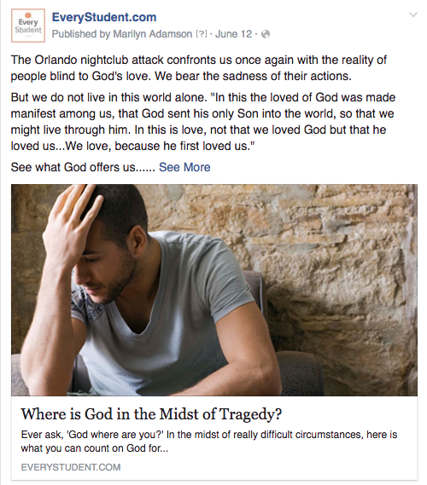

Slide 13
